Slide 1
Project Review
Keshav

Slide 2
Abstract
Overview :
In this assignment you will predict candidates hiring likelihood. The dataset provided contains attributes for 690 candidates.
Task:
For this assignment, build a classification model predicting whether candidate will get hired or not using Python.

Slide 3
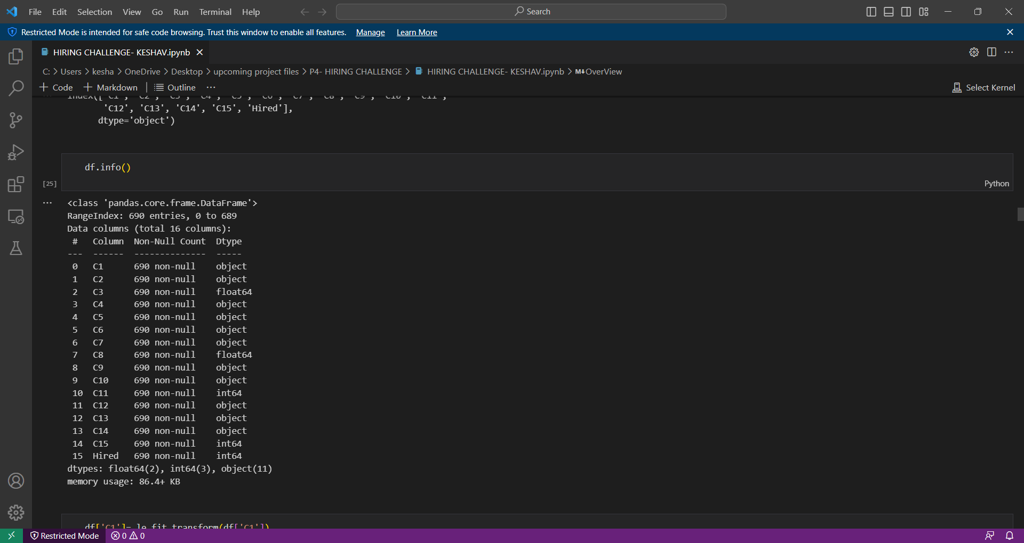
Data Exploration
In this assignment you will predict candidates hiring likelihood. The dataset provided contains attributes for 690 candidates.
In this dataset, there are 11 columns with categorical variables and 2 columns with floating DT and 2 column with integer DT,so totally 16 columns
In this dataset, there are no null values
Used Pandas Profilling library for insightful informations and clean and understandable EDA.

Slide 4
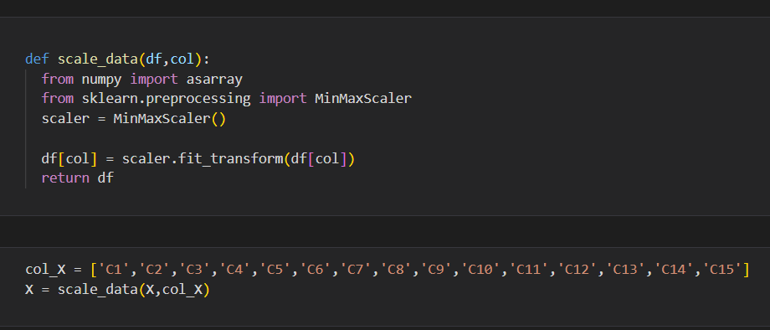
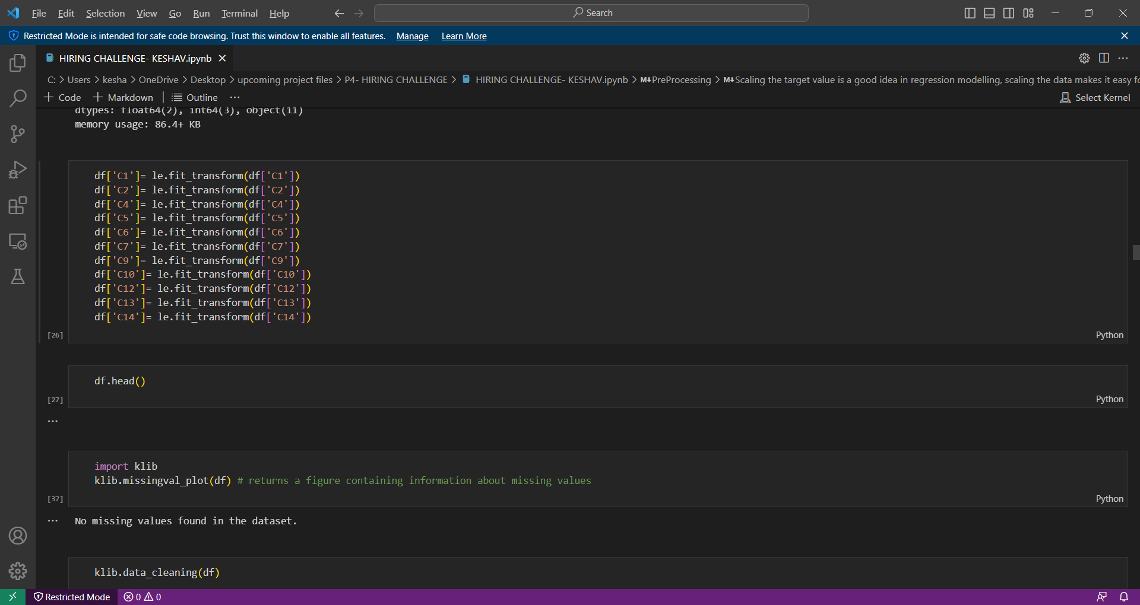
Data Pre Processing
Label Encoding:
In this dataset, there are lot of 0’s& 1’s format, so performed one hot encoding. So after transforming those columns, it turns into binary format(101,010,110 format).
Scaling the data:
Scaling the target value is a good idea in regression modelling, scaling the data makes it easy for a model to learn and understand the problem.
We use MinMaxScalar, it helps to shrink the data within the given range,usually between 0 to 1. It transforms data by scaling the features to a given range.

Slide 5
Modelling Technique
Modelling is a way of training the model using ML
There are lot of ways modelling the training model
Have tried all algorithms like Logistic Regression,Random forest,adaboost,svm,decision tree etc...
Performed confusion report,and got accuracy score.
Out of all these algorithms, XGboost algorithms performs very well with an accuracy of 94%.

Slide 6
Hyperparameter Tuning
Hyperparameter is a parameter whose value is set before the learning process begins.
Hyperparameters tuning is crucial as they control the overall behavior of a machine learning model.
There are usually performed by 2 types(Grid search, Random Search). Out of these two, Random search is always better, because it picks random value from different combination. So I have tried performing RandomSearchCV.

Slide 7
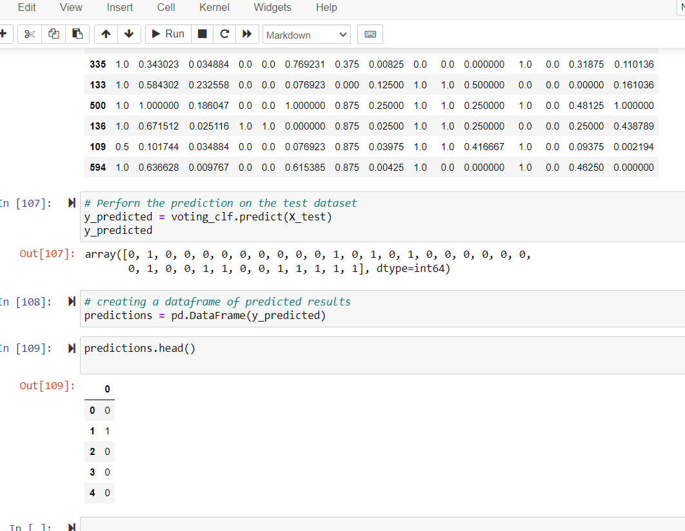
Continuation....
After performing the required calculation on training data,now its time to perform it on test data( Hired column).
Now we will apply voting algorithm and check the data values(scaled values).

Slide 8
Conclusion
Now we can say whether they have hired the candidate or not by using ML algorithms and it states that it is 94% accurate.
If the output is 1, then candidate is likely to get hired, else if the output is 0, candidate is not hired.

Slide 9
Future Improvements
Inorder to make it a better application, we can apply the following ideas:
1. We can create a backend application using flask/django and deploy it on cloud.
2. Those who have not got selected, we can create a database using SQL and we can store their resumes/informations on the database. So when the role appears to be match their profile,then we can retrieve and call them for interviews.

